Slide 1
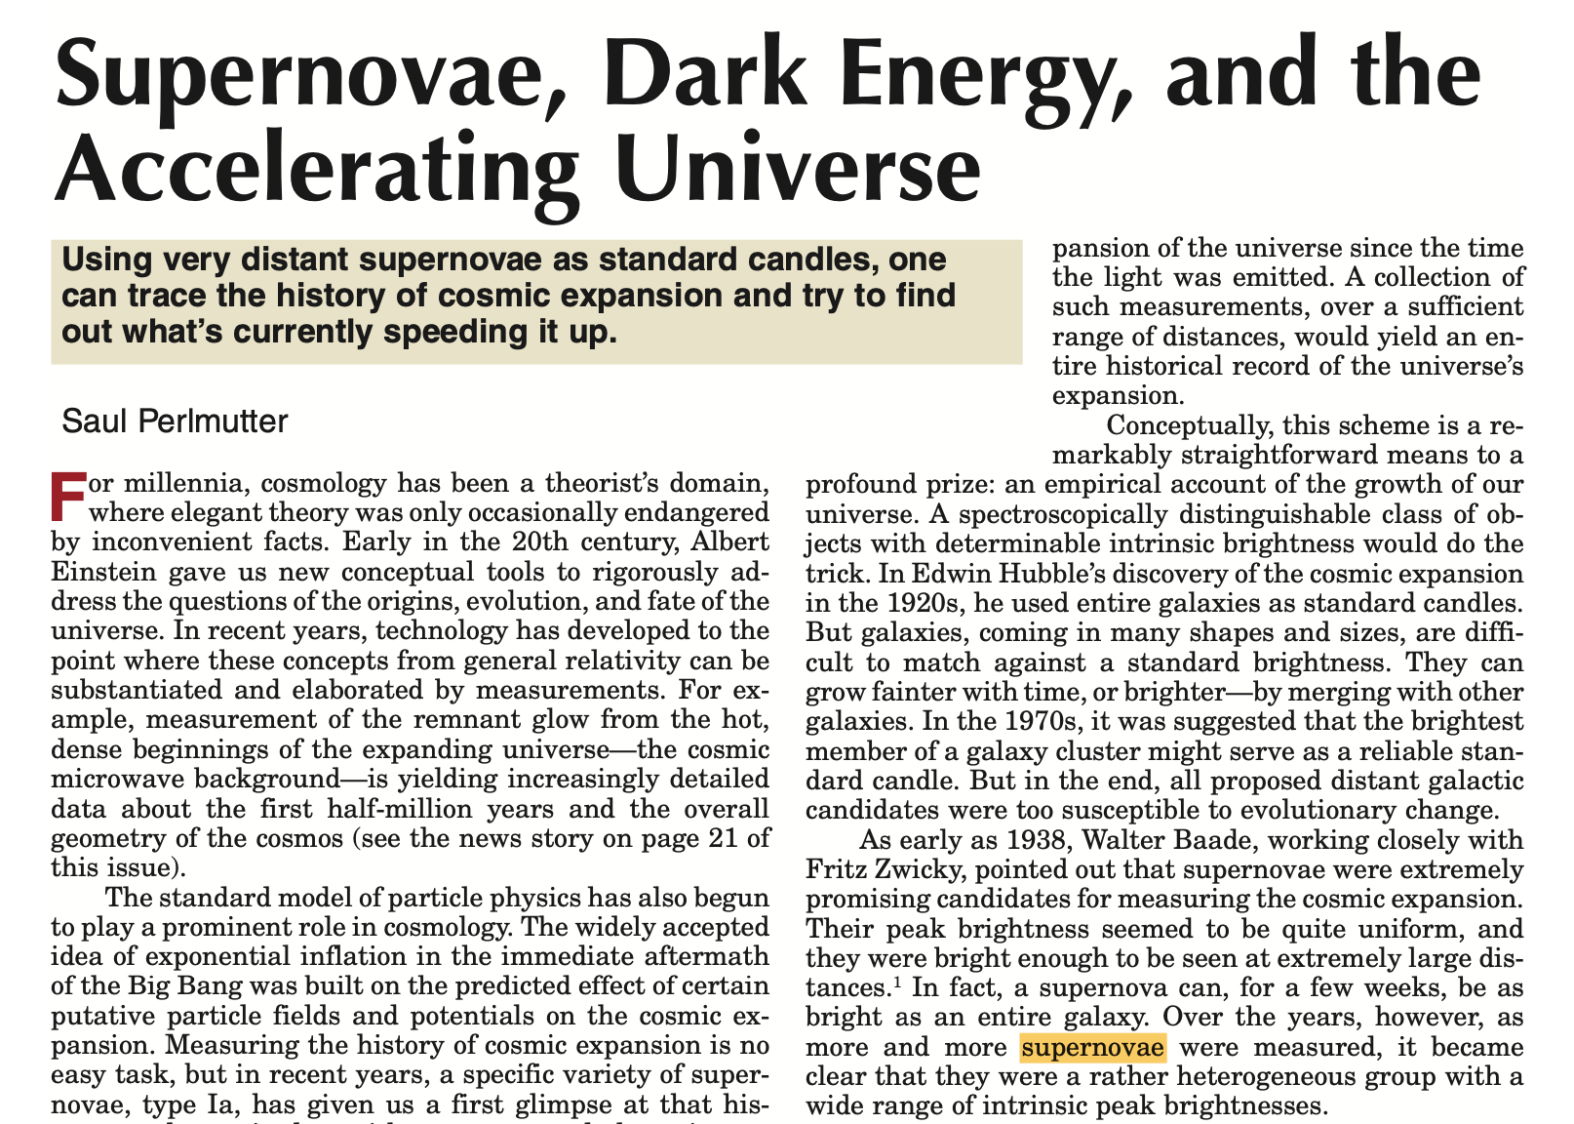
Mykolas Understanding of:

Slide 2
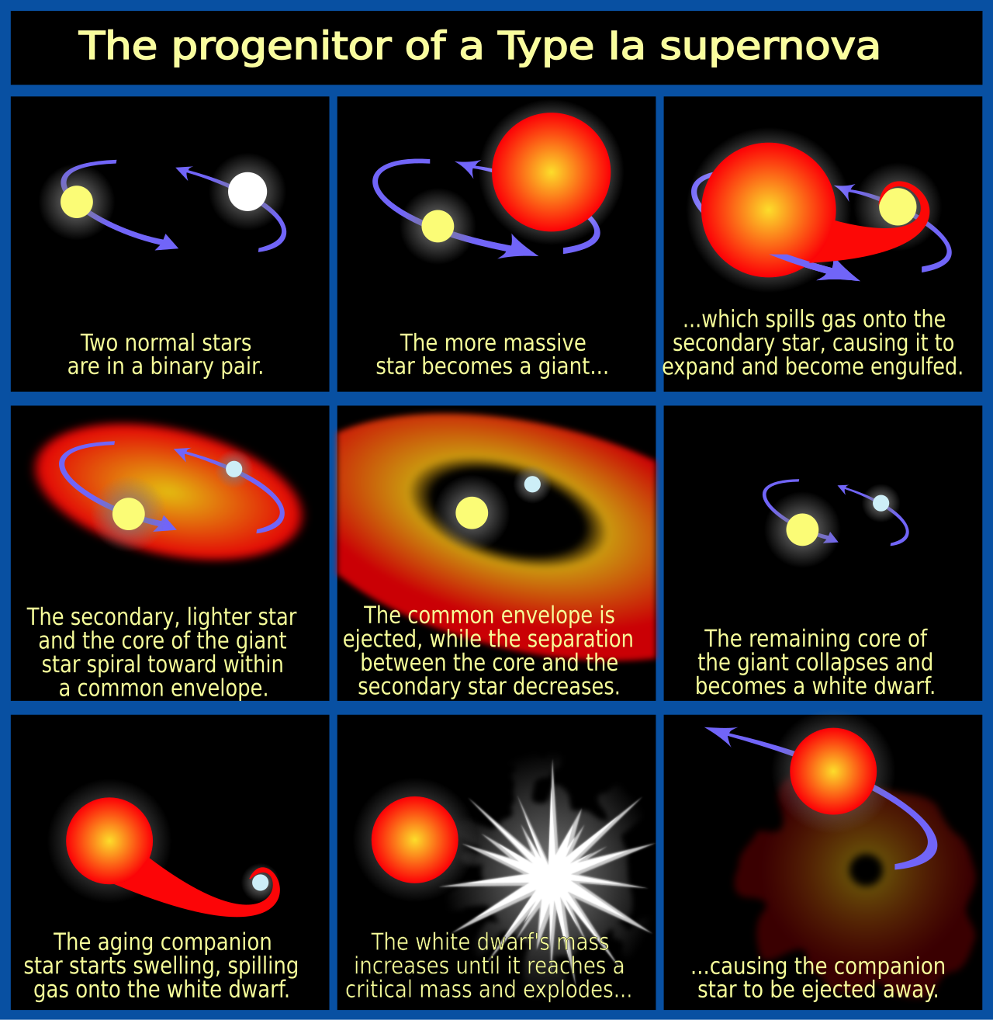
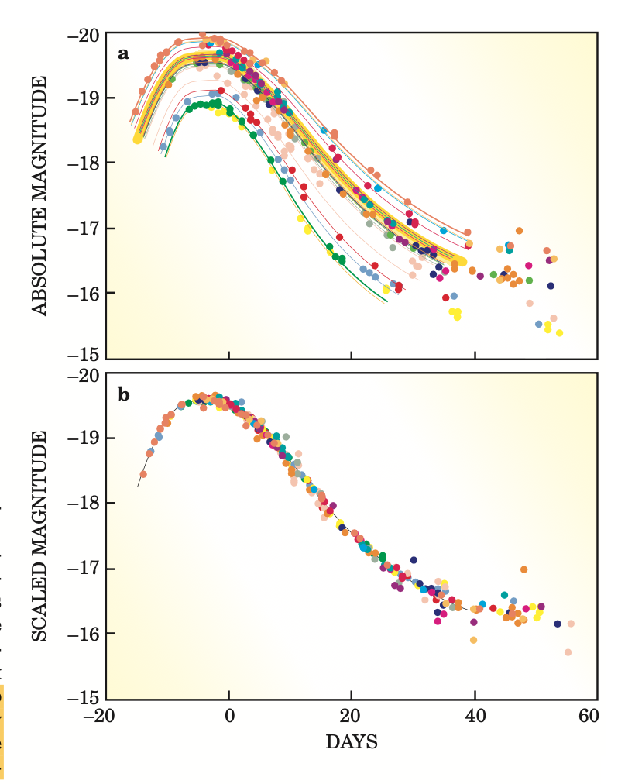
Shape of Light Curves
Signature
Of Type Ia Supernovae

Slide 3
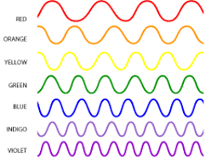
What is Red Shift
Cosmological Redshift:
Caused by the expansion of the universe. As light from distant galaxies travels through space, space itself stretches, causing the wavelengths of light to stretch as well.

Slide 4
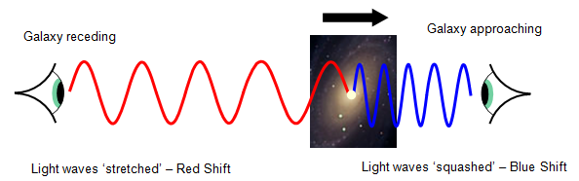
What is Red Shift Cont.
Doppler Redshift (Most Important) (Purely Based on Motion)

Slide 5
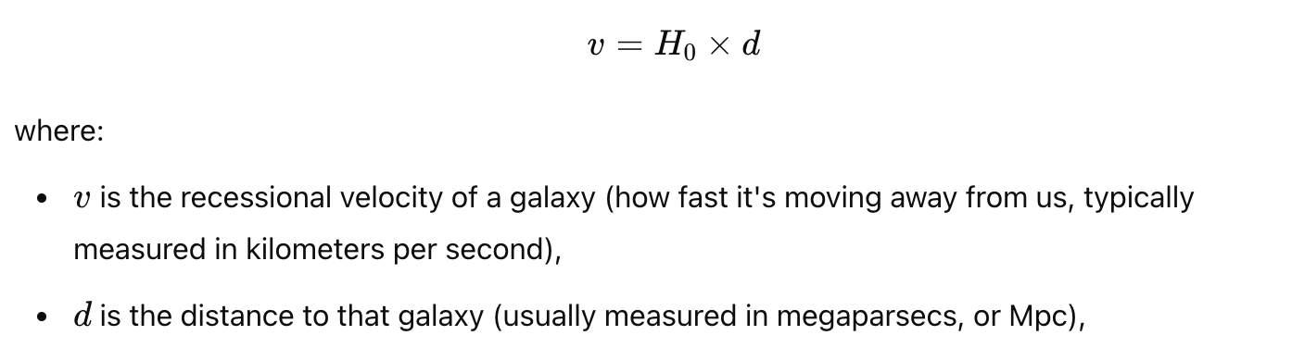
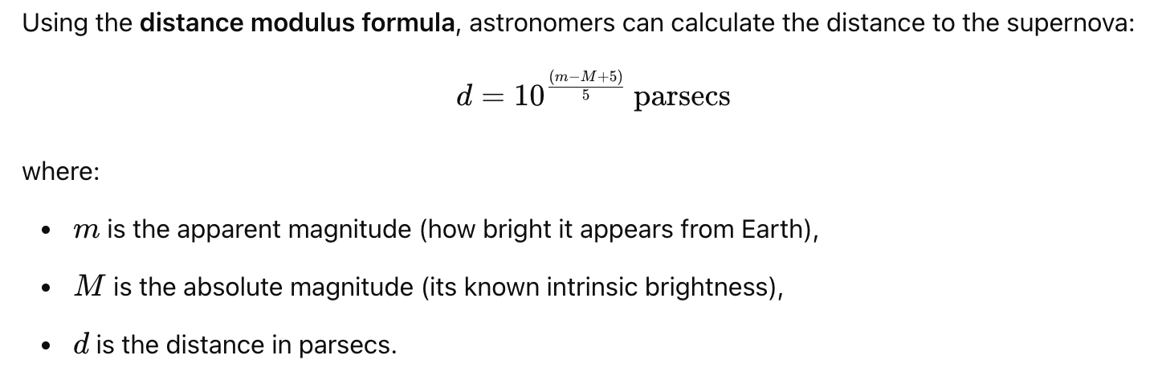
Purpose and Motivation
Insights into Expansion Rate of the Universe:

Slide 6

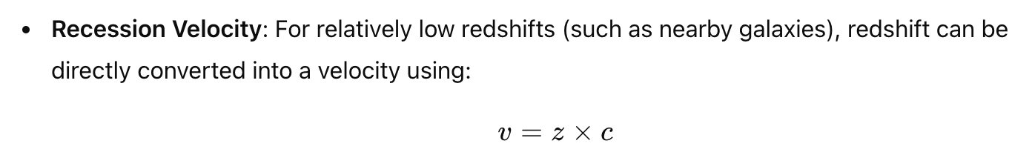
Purpose and Motivation Cont.

Slide 7
Question
How do you distinguish doppler red shift from cosmological red shift in spectroscopic measurements?
Am I right? Are Hubble constant calculations done using doppler redshift?

Slide 8
Concept: Battle of Universal Froces (Abstract 2 Mykola)
Mass Density (Gravitational Attempting to Get Universe to Contract)
Dark Energy / Vaccuum Energy (pushes universe to expand)
Evidence of this is that further away supernovae are moving away at an accelerating rate.

Slide 9
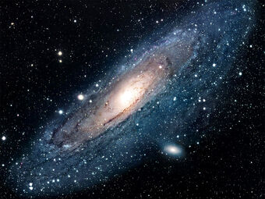
Observing Strategy: Conceptual Visualization
Try to Find a Fresh Type Ia
Supernova Explosion Which
Would be a spec in this galaxy.
Use Light curves to identify if
Its Type Ia

Slide 10
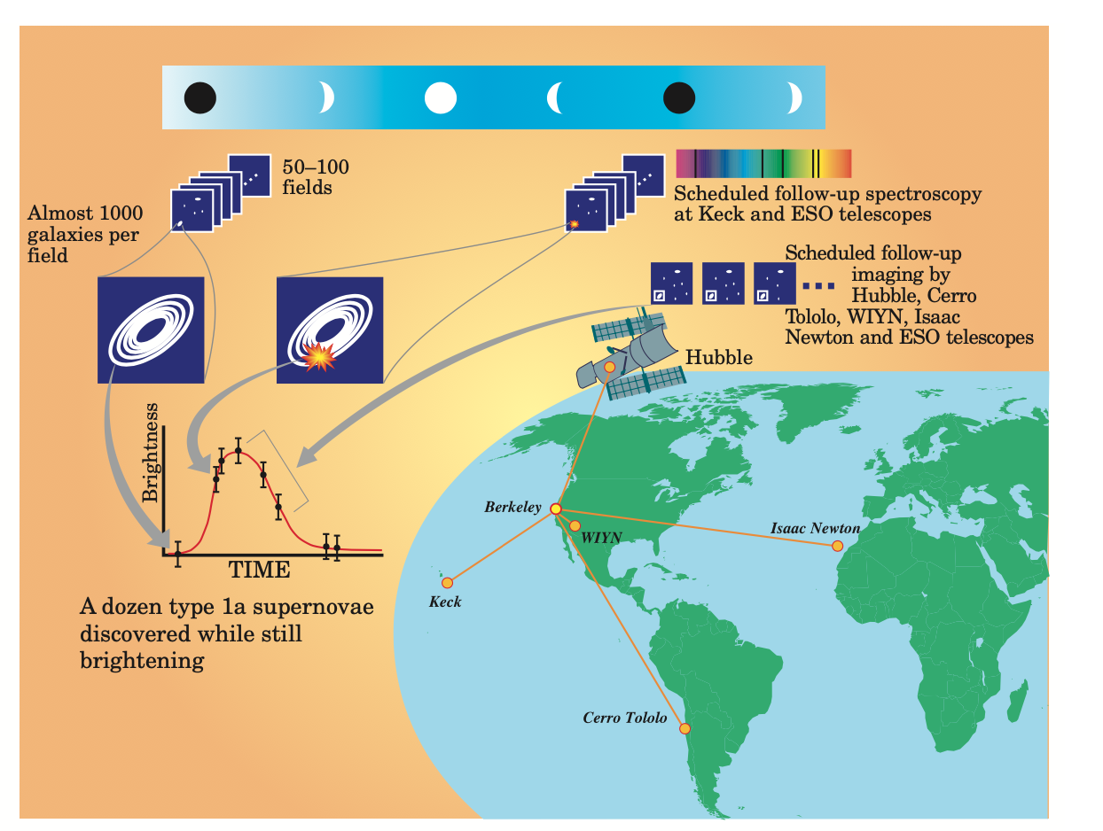
Observing Strategy
Timescale: ~60 days
Observing Strategy:
Use ground based telescopes to observe galaxies during the dark cycle of the moon (eliminates light pollution). If galaxy identified: schedule satellite spectroscopy equipment to collect spectra before explosion dies down and disappears (preferably at peak brightness of the explosion).

Slide 11
Observing Strategy – MWV Lab
Connection to Chris:
Using data science, create an alert system to know as soon as possible when a Type Ia supernovae explodes, collect, and store data.
Connection to Shu:
Using image analysis: analyze before and after pictures to identify a signal of interest that may be a Type Ia supernovae (determined by shape of light curve).

Slide 12
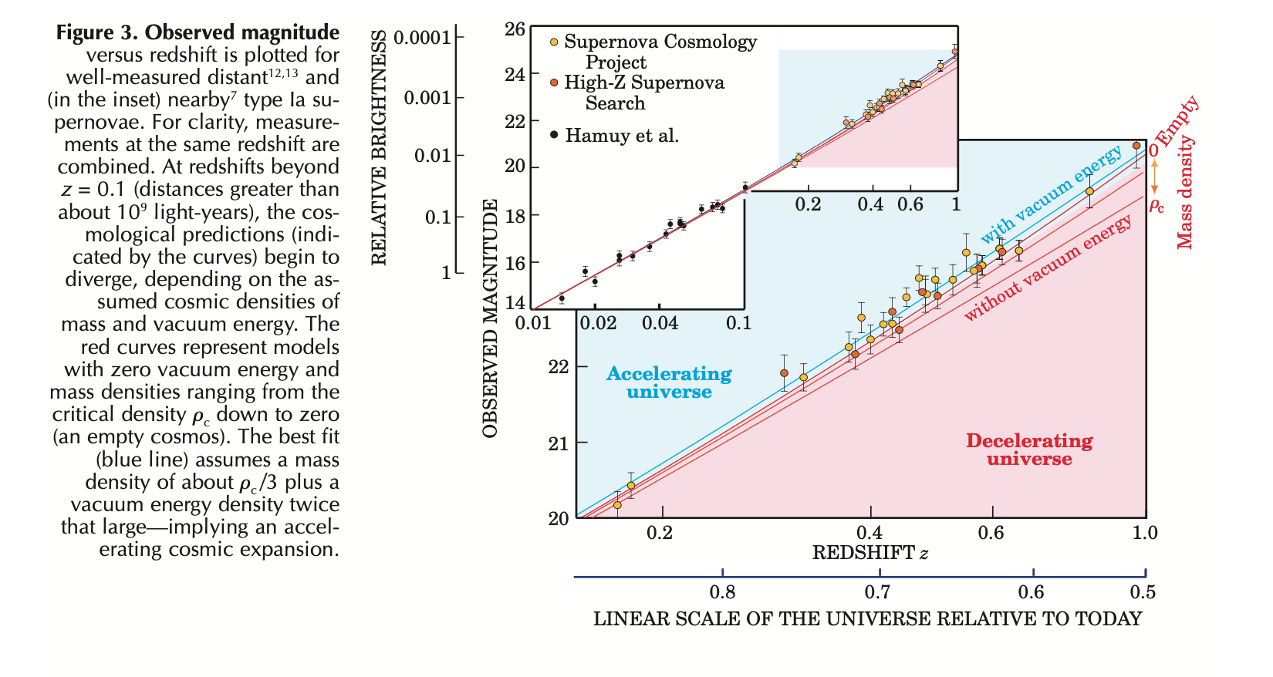
✌Hubble Diagram✌
Takeaways: best fit data shows universe is expanding under acceleration. Also shows that vacuum energy exists. Could only be told by distance galaxies.

Slide 13
Cool Physics / Surface Level knowledge gained:
Electron Degeneracy pressure in White Dwarfs.
Flat geometry of the cosmos.
Intervening Dust.
Zenith Troposphere delay - Big yellow box in MWV garage.
Vacuum energy

Slide 14
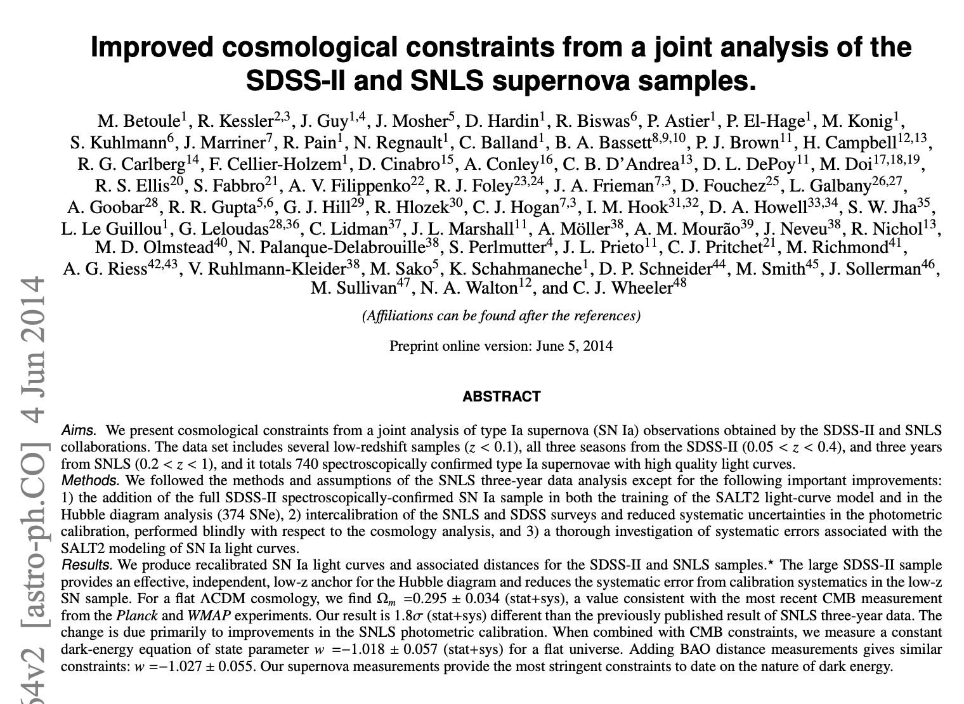
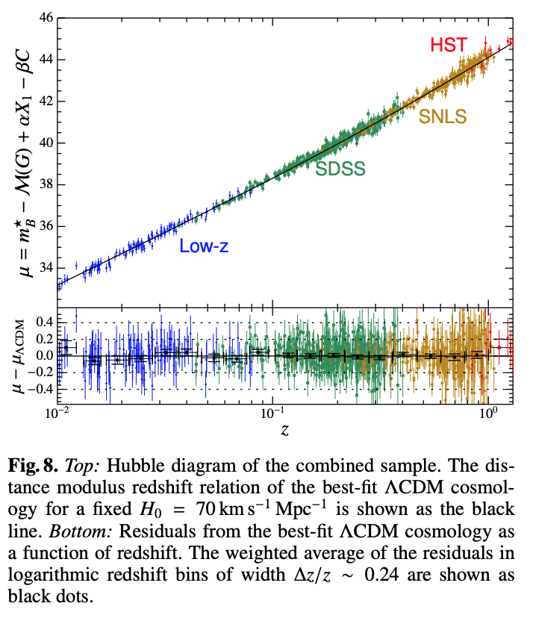
Next Steps
READ
REPRODUCE

